Slide 1
 | Trial 1 | Trial 2 | Trial 3
Sampling Days (0=spawn) | W:1,12 / OS:5,12 | W:1,9 / OS:6,9 | W: 5,8,12
Sample Types | Water, Swabs, Oysters | Water, Swabs, Oysters | Water
Water Filtered | 410-750ml | 7-10ml | 1300-1700ml
Trial Dates | July 11-23, 2012 | Jan 9-18, 2013 | June 3-15, 2016
Bacterial reads from 12 water samples | 1.3 million | 1.8 million | 5.7 million
Methods | MoBio extraction MiSeq, 2x250 PE | MoBio extraction MiSeq, 2x250 PE | Puregene extraction HiSeq, 2x100 PE
16S region | V3-V4 | V3-V4 | V6
Notes:
Table 1. Summary of probiotic trial information and sequencing data for all three trials.

Slide 2
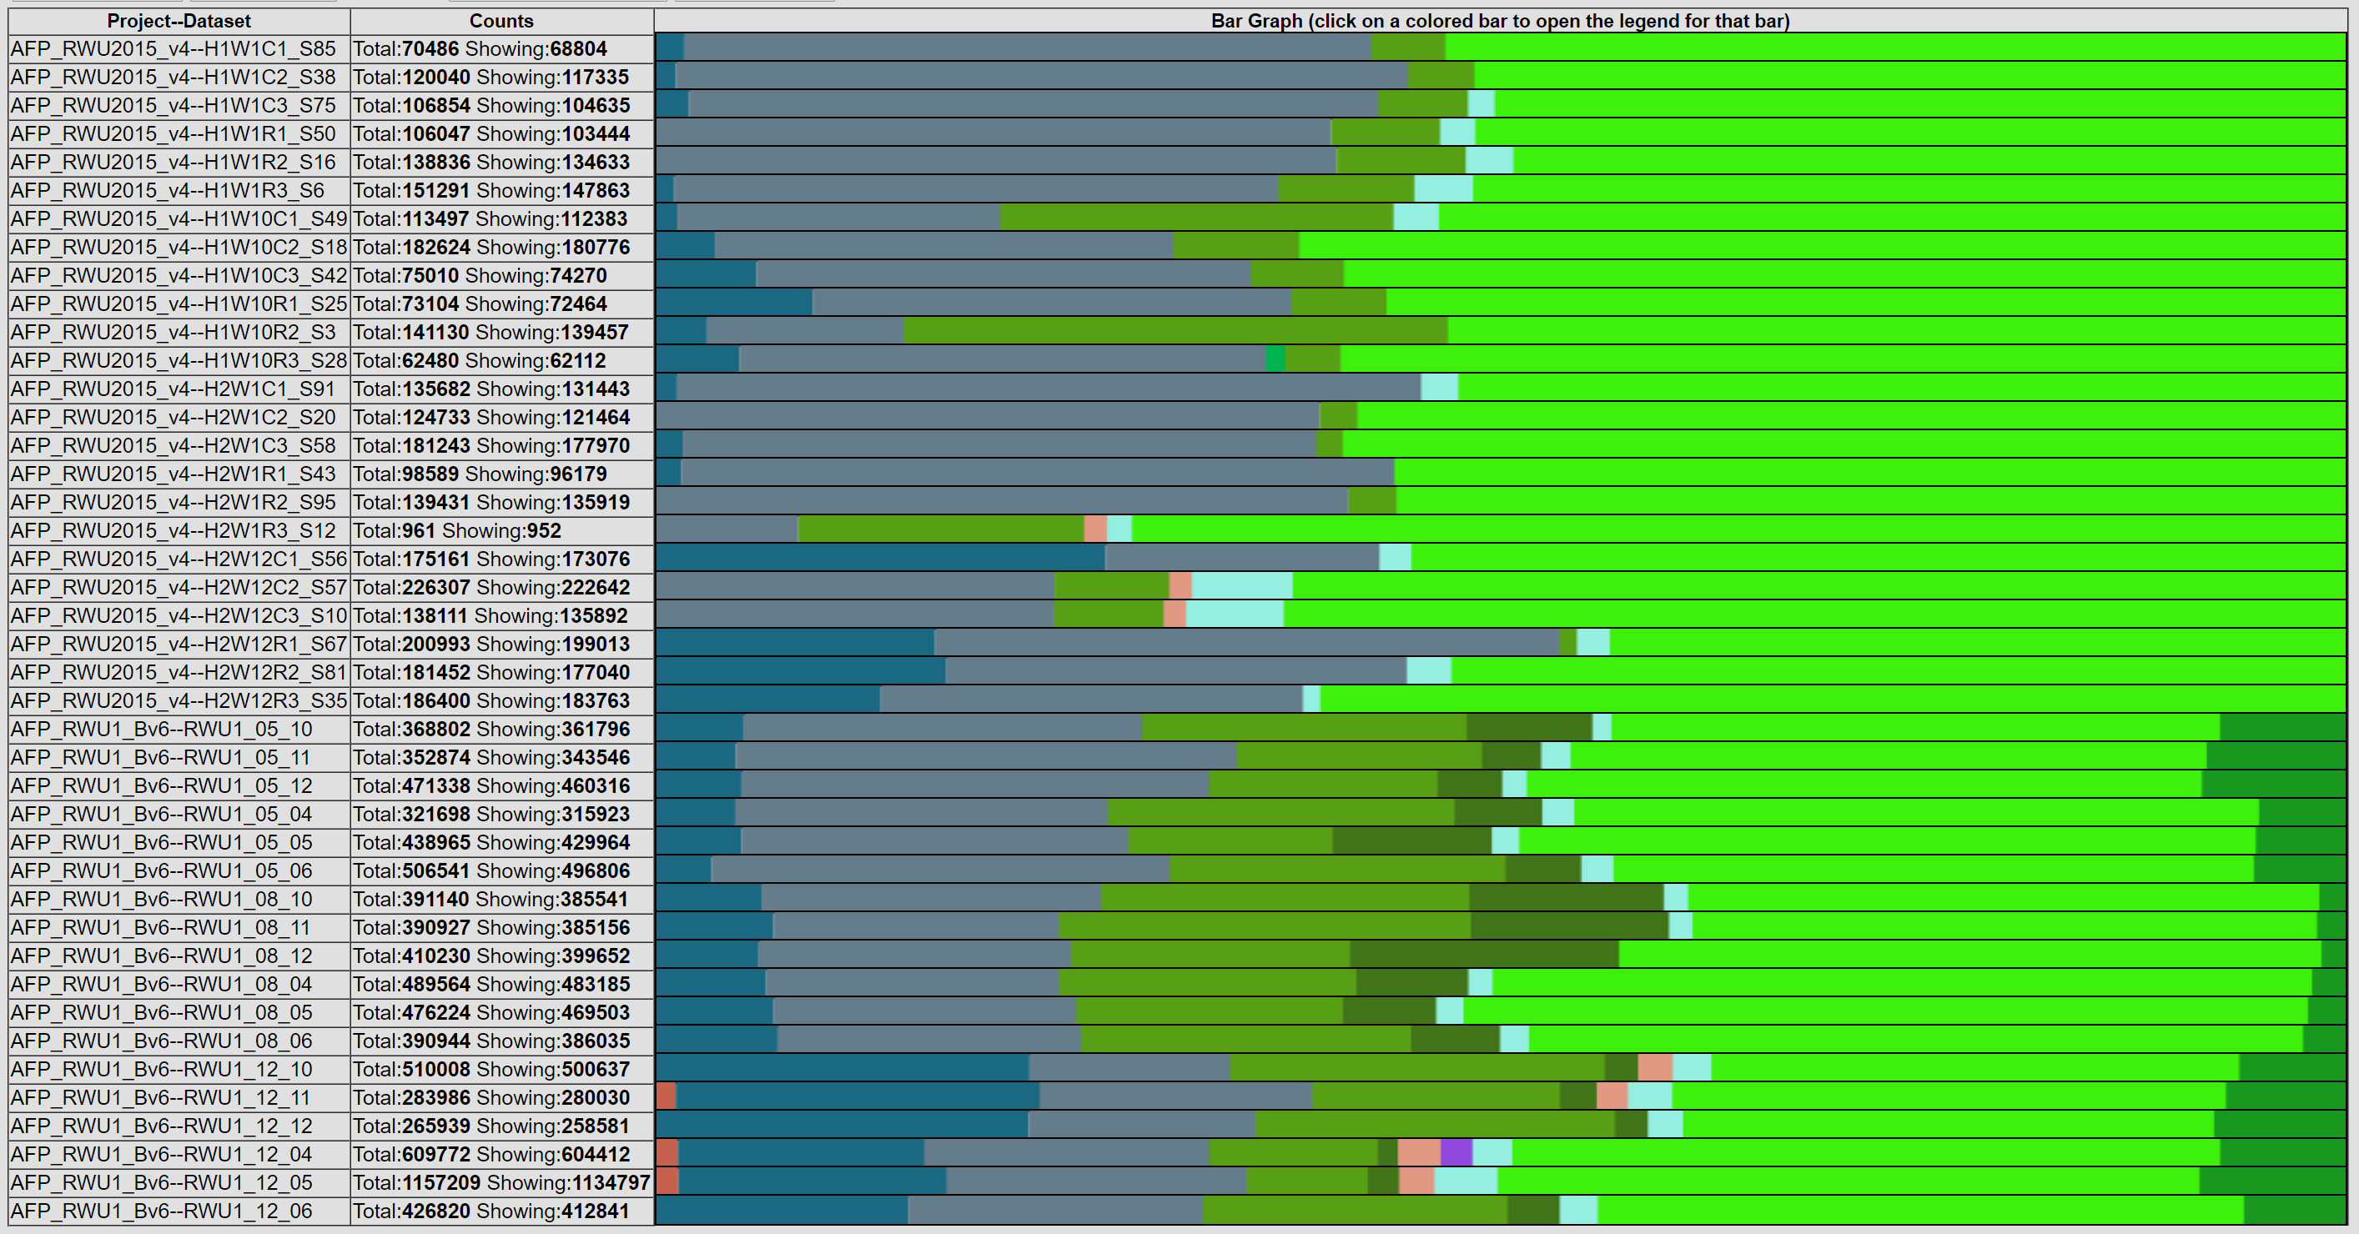
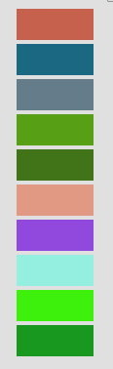
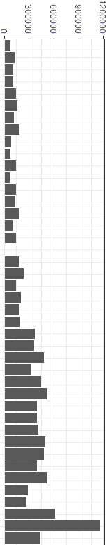
Trial
Day
Group
Abundance
1
2
3
1
12
1
9
5
8
12
Con
Treat
Con
Treat
Acidobacteria
Actinobacteria
Bacteroidetes
Cyanobacteria
Deferribacteres
Firmicutes
Lentisphaerae
Planctomycetes
Proteobacteria
Unknown
Con
Treat
Con
Treat
Con
Treat
Con
Treat
Con
Treat
Notes:
Figure 1. Percent abundances of known phyla in water samples from all 3 Trials based on 16S rDNA amplicon sequencing data. The total abundance of sequencing reads is shown in the bar graph. The 9 dominant phyla include Acidobacteria, Actinobacteria, Bacteroidetes, Cyanobacteria, Deferribacteres, Firmicutes, Lentisphaerae, Planctomycetes, and Proteobacteria.
Decrease in Bacteriodetes
Increase in Acinobacteria

Slide 3
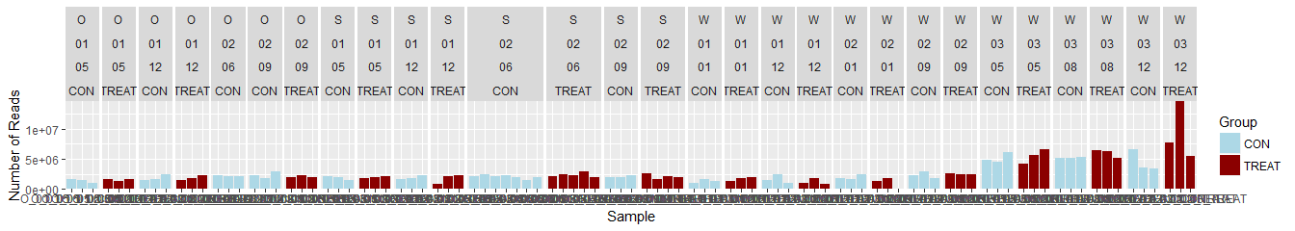
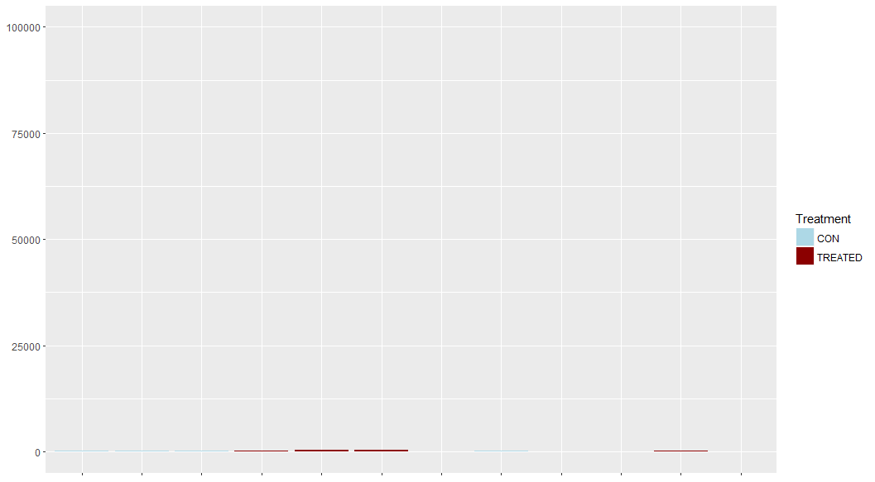
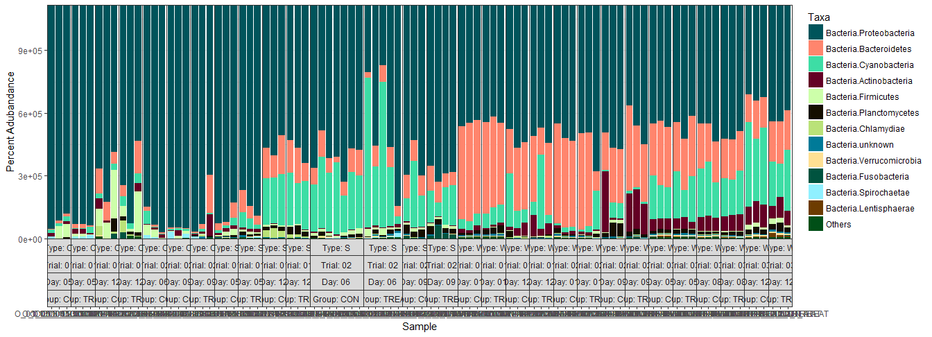
1e+07
5e+06
0
Group
CON | T | CON | T | CON | CON | T |  | CON | T | CON | T | C O N | T | CON | T |  | CON | T | CON | T | CON | T | CON | T | CON | T | CON | T | CON | T | Group
5 |  | 12 |  | 6 | 9 |  |  | 5 |  | 12 |  | 6 |  | 9 |  |  | 1 |  | 12 |  | 1 |  | 9 |  | 5 |  | 8 |  | 12 |  | Day
1 |  |  |  | 2 |  |  |  | 1 |  |  |  | 2 |  |  |  |  | 1 |  |  |  | 2 |  |  |  | 3 |  |  |  |  |  | Trial
Oyster Larvae |  |  |  |  |  |  |  | Biofilm Swab |  |  |  |  |  |  |  |  | Rearing Water
Control
Treatment
Number of Reads
Phylum
75
50
25
0
Percent Abundance (%)
Figure 1. Percent abundances of the 12 most abundant phyla in all oyster larvae, biofilm swab, and rearing water samples from all 3 Trials based on 16S rDNA amplicon sequencing data (bottom). The total abundance of sequencing reads is shown in the bar graph (top). The 12 dominant phyla include Actinobacteria, Bacteroidetes, Cyanobacteria, Deferribacteres, Firmicutes, Fusobacteria, Lentisphaerae, Planctomycetes, Proteobacteria, Spirochaetae, Verrucomicrobia, and Unknown.
Notes:
Decrease in Bacteriodetes
Increase in Acinobacteria
1344x486
1344x240

Slide 4
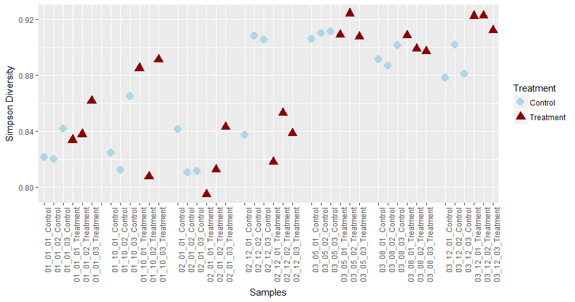
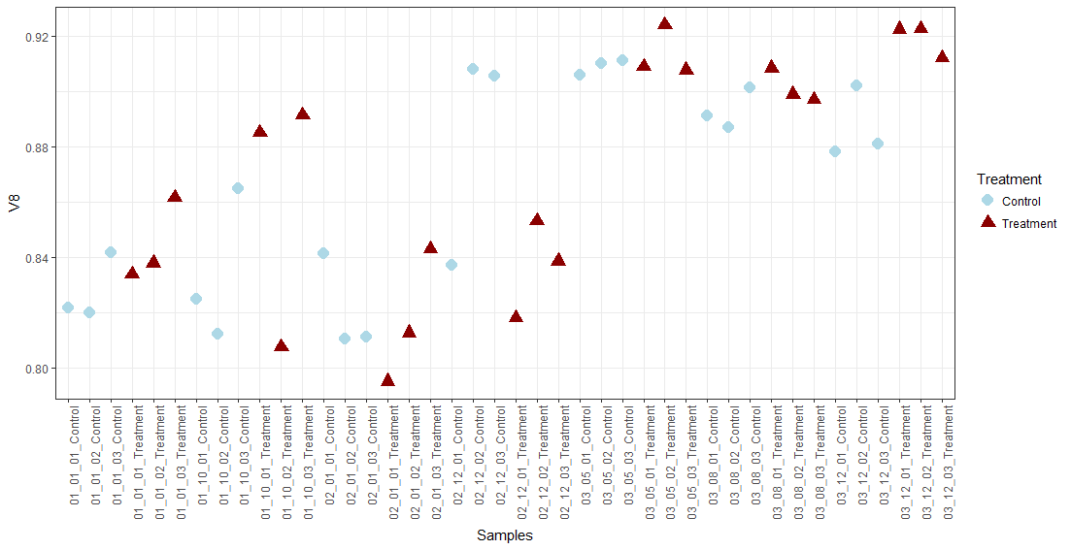
Group
Simpson Diversity
Day 1 Day 12
Day 1 Day 9
Day 5 Day 8 Day 12
Trial 1
Trial 2
Trial 3
Notes:
Figure 2. Simpson’s index of diversity of bacterial communities in all water samples in all 3 trials. No significant differences were found over time or between treatments, due to high variation in the replicate tanks.
903 x 475

Slide 5
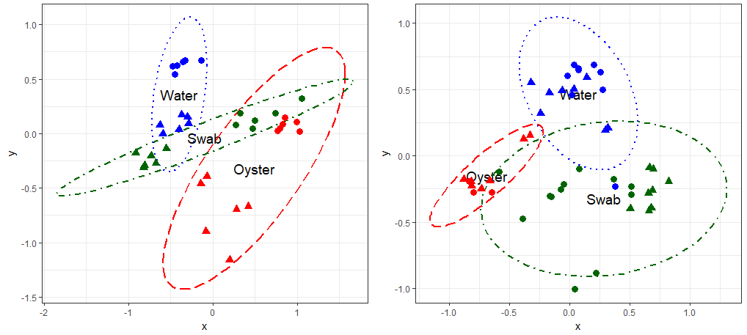
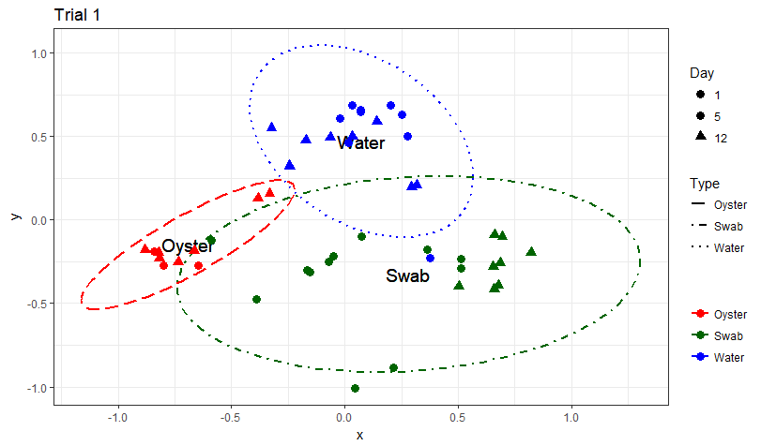
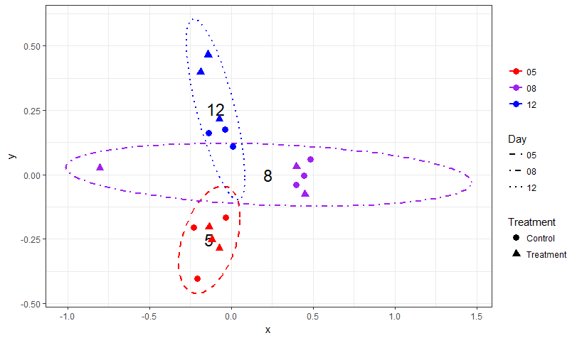
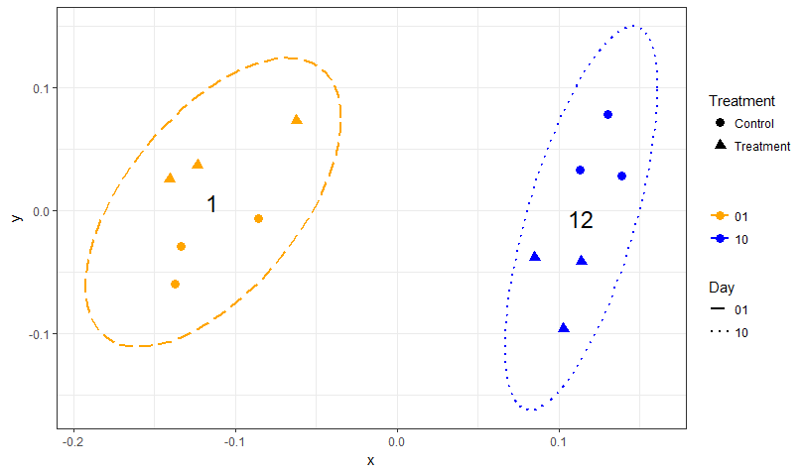
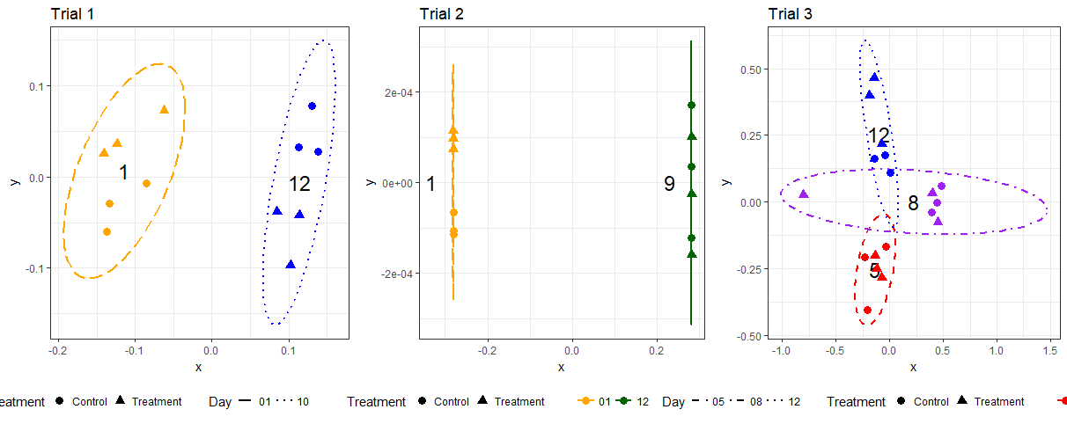
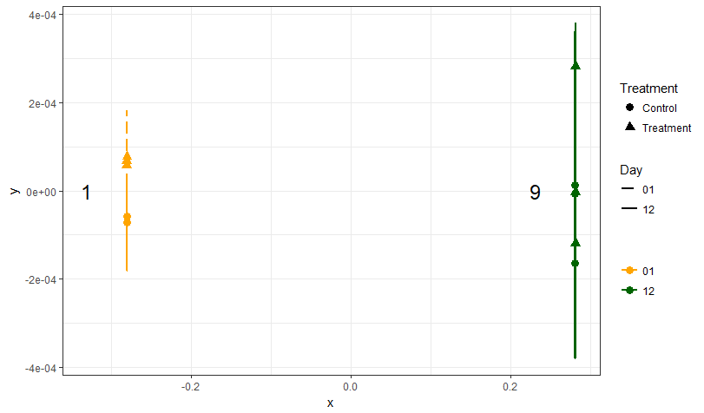
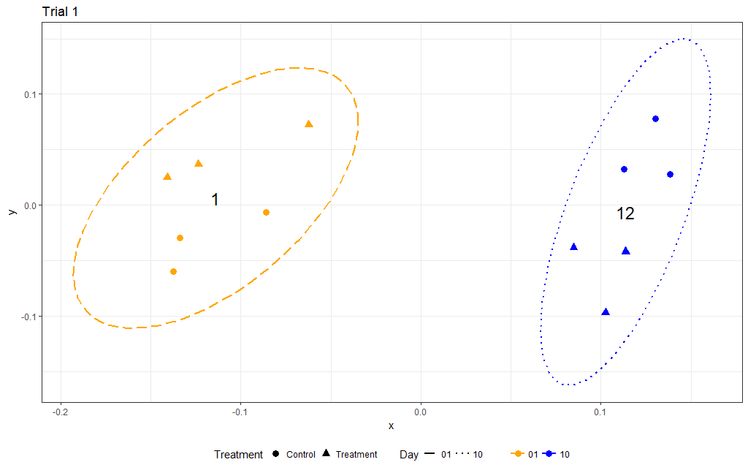
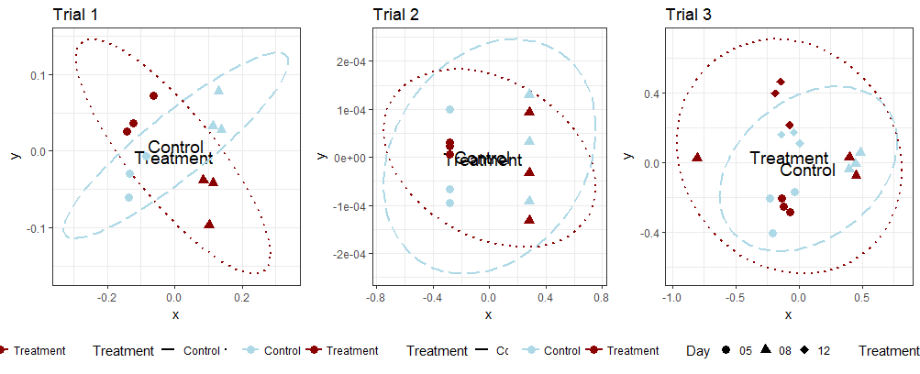
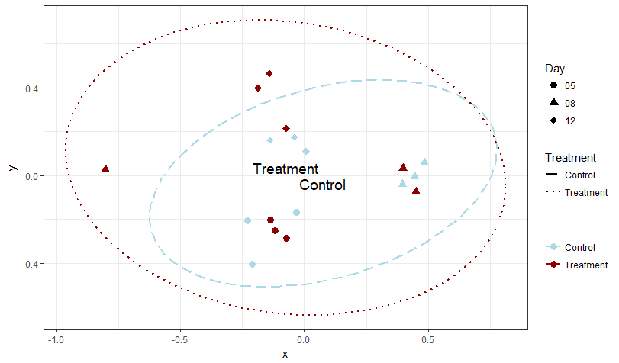
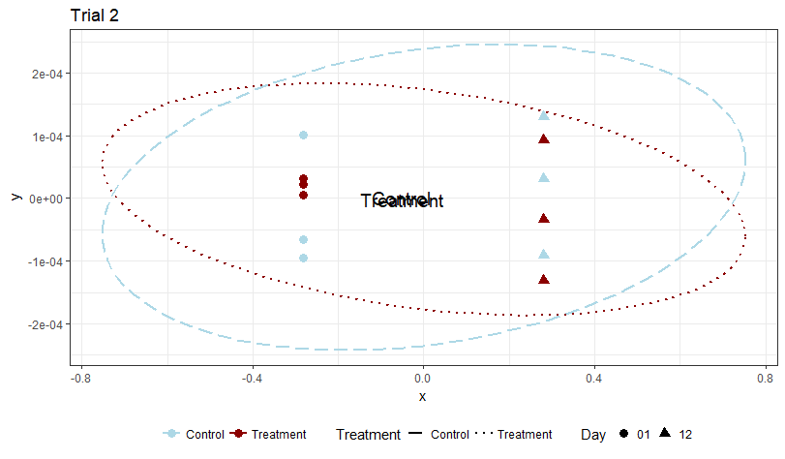
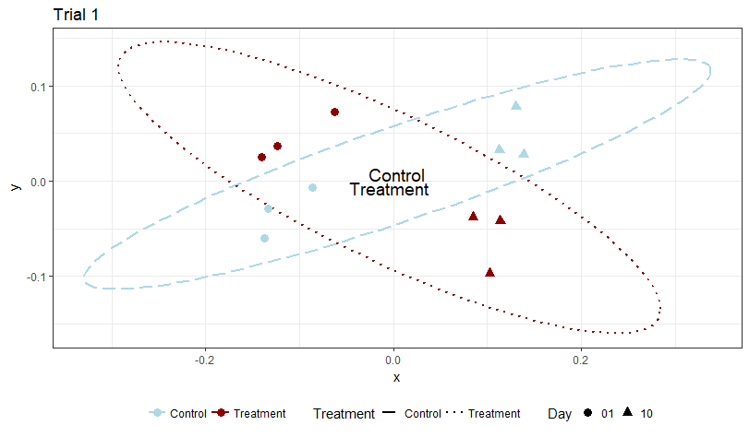
Trial 1
Trial 2
Trial 3
Day 1/5/6 Day 9/12
a. Sample Type
Day
1
5
8
9
12
b. Day
c. Treatment Group
09
Notes:
Figure 3. NMDS plots calculated using Bray-Curtis beta-diversity (k=2) at the Order level by sample type for Trials 1 (a) and 2 (b). The different types of samples are indicated by colors (Oyster=dashed red, Swab=dashdot green, Water=dotted blue) and the days are indicated by symbols (Timepoint 1=circle, Timepoint 2=triangle). The lines show the 95% confidence interval. The water and swab communities are significantly distinct from each other in both trials.
Figure 4. NMDS plots calculated using Bray-Curtis beta-diversity (k=2) at the Order level for water samples by day in Trials 1 (a), 2 (b), and 3 (c). The sampling timepoints are indicated by colors (1=longdash yellow, 5=shortdash red, 8=dashdot purple, 9=solid green, 12=dotted blue) and the treatment group is indicated by symbols (Control=circle, Probiotic treatment=triangle). The lines show the 95% confidence interval. The water community is significantly different between timepoints.
Figure S3. NMDS plots calculated using Bray-Curtis beta-diversity (k=2) at the Order level for water samples by treatment in Trials 1 (a), 2 (b), and 3 (c). The treatment group is indicated by colors (Control=light blue dashed, Probiotic treatment=dark red dotted) and sampling timepoints are indicated by symbols. The lines show the 95% confidence interval. The water community is not significantly different according to treatment.

Slide 6
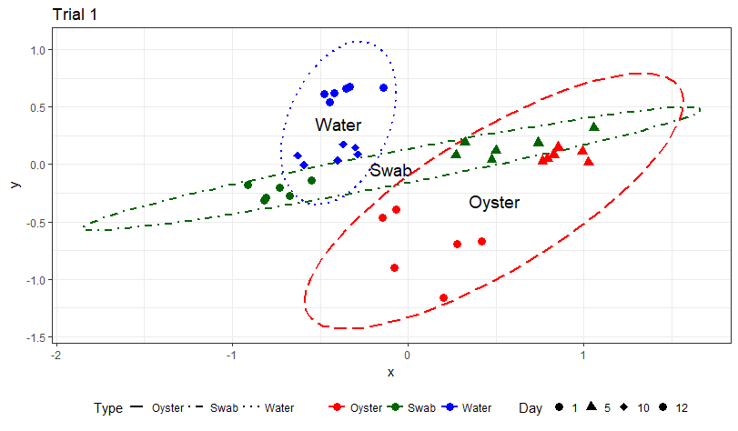
a) Trial 1
b) Trial 2
Sample Type
Day
1/5/6 9/12
Notes:
Figure 3. NMDS plots calculated using Bray-Curtis beta-diversity (k=2) at the Order level by sample type for Trials 1 (a) and 2 (b). The different types of samples are indicated by colors (Oyster=dashed red, Swab=dashdot green, Water=dotted blue) and the days are indicated by symbols (Timepoint 1=circle, Timepoint 2=triangle). The lines show the 95% confidence interval. The water and swab communities are significantly distinct from each other in both trials.

Slide 7
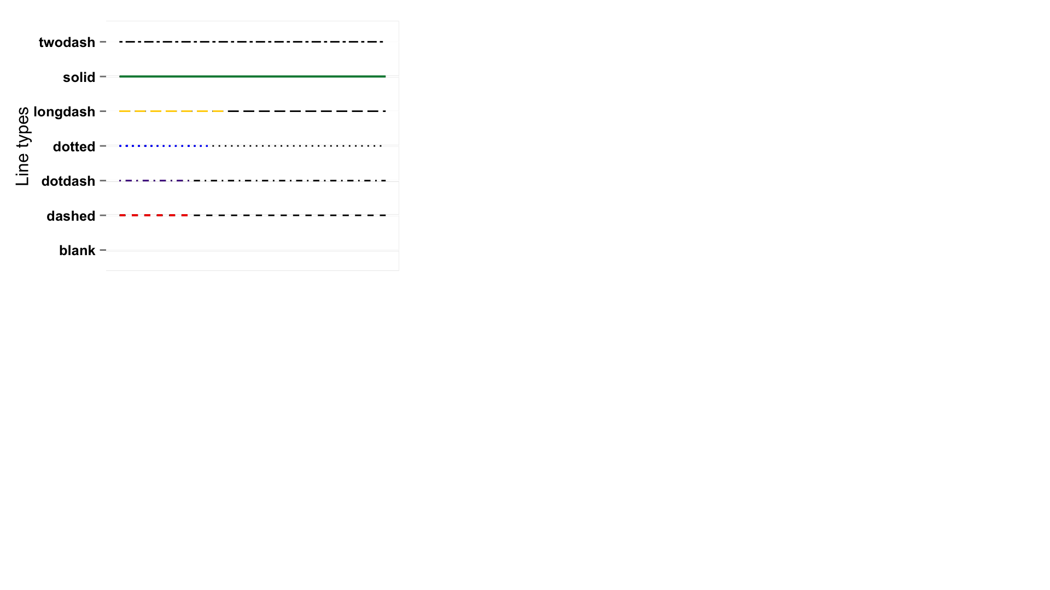
a) Trial 1
b) Trial 2
c) Trial 3
Group
Day
1 5 8 9 12
Notes:
Figure 4. NMDS plots calculated using Bray-Curtis beta-diversity (k=2) at the Order level for water samples by day in Trials 1 (a), 2 (b), and 3 (c). The sampling timepoints are indicated by colors (1=longdash yellow, 5=shortdash red, 8=dashdot purple, 9=solid green, 12=dotted blue) and the treatment group is indicated by symbols (Control=circle, Probiotic treatment=triangle). The lines show the 95% confidence interval. The water community is significantly different between timepoints.

Slide 8
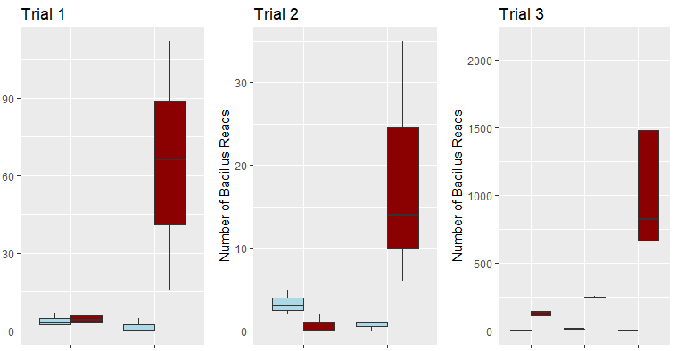
Trial 1
Trial 2
Trial 3
Group
Number of Bacillus Reads
Control
Treatment
Day 1 Day 12
Day 1 Day 9
Day 5 Day 8 Day 12
Notes:
Figure 5. Number of Bacillus reads in treated and control water samples (n=3) on Days 1 and 12 (Trial 1), Days 1 and 9 (Trial 2), and Days 5, 8 and 12 (Trial 3). Control is indicated by light blue boxplots and probiotic treatment is indicated by dark red boxplots. Bacillus is consistently more abundant in the treated than the control water on the second (and third) timepoint in all 3 trials.

Slide 9
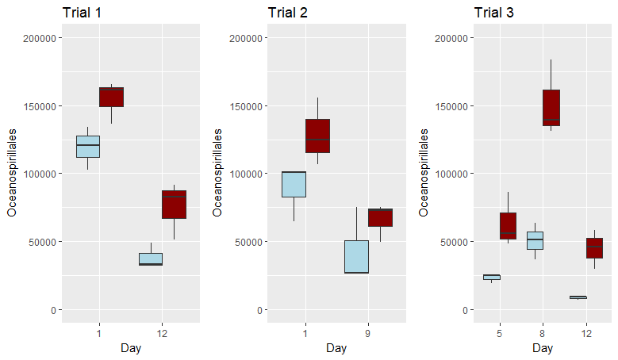
Trial 1
Trial 2
Trial 3
Group
Control
Treatment
Number of Oceanospirillales Reads
Day 1 Day 12
Day 1 Day 9
Day 5 Day 8 Day 12
Notes:
Figure 6. Number of Oceanospirillales reads in treated and control water samples (n=3) on Days 1 and 12 (Trial 1), Days 1 and 9 (Trial 2), and Days 5, 8 and 12 (Trial 3). Control is indicated by light blue boxplots and probiotic treatment is indicated by dark red boxplots. Oceanospirallales are consistently more abundant in probiotic-treated tank rearing water, and decrease with time.

Slide 10
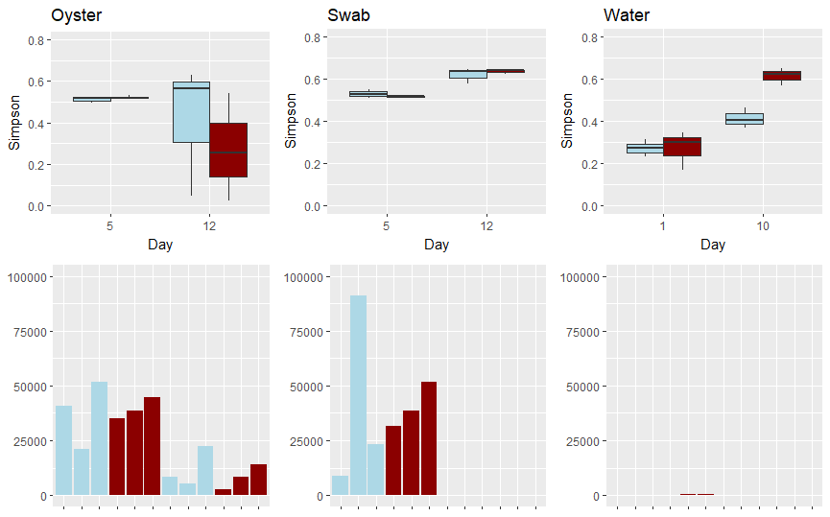
Simpson Diversity
Day 5 Day 12
Day 5 Day 12
Day 1 Day 12
Group
Control
Treatment
Number of Vibrio Reads
Notes:
Figure 7. Total Vibrio read abundance (bottom, bar graph) and Simpson’s Index of Diversity (top, boxplots n=3) in all samples types on Days 1/5 and 12 from Trial 1. Total Vibrio reads are the most diverse in the tank biofilms (swab), and most abundant in the oyster and swab samples on Day 5.

Slide 11
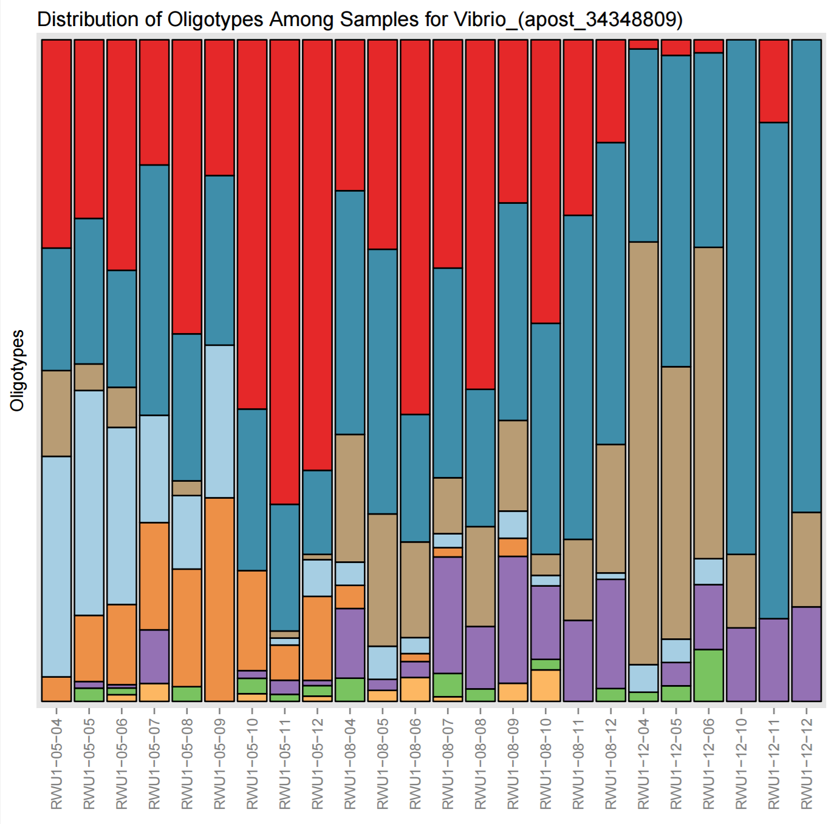
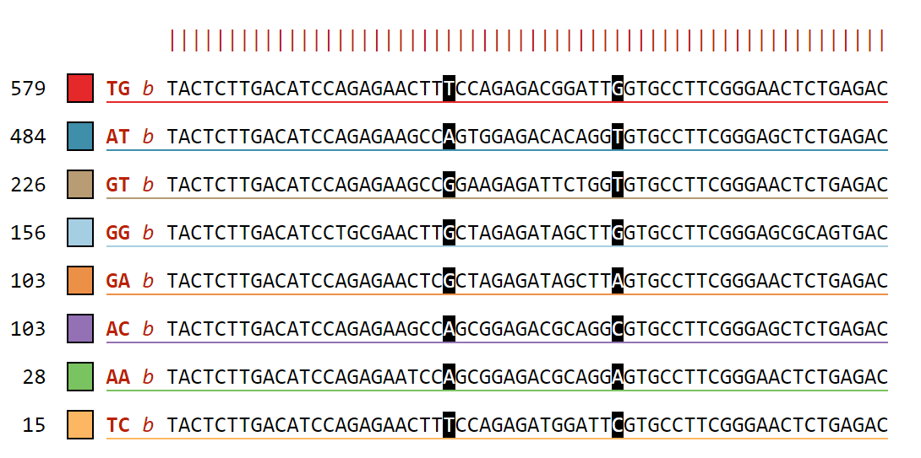
TG: Vibrio alginolyticus strain WW1 16S ribosomal RNA gene GenBank: KX425011.1
AT: Vibrio celticus partial 16S rRNA gene, isolate 5OM18 GenBank: LN832936.1
GT: Vibrio orientalis partial 16S rRNA gene, isolate LK2HaP4 GenBank: LT221239.1
GG: Halovibrio sp. strain 5F5 16S ribosomal RNA gene, partial sequence GenBank: KY636397.1
T CON T CON T CON
Day 5 Day 8 Day 12
Notes:
Figure 8. Vibrio spp. oligotypes in Treatment (T) and Control (CON) water samples on Days 5, 8, and 12 from Trial 3. These 8 oligotypes were generated from changes in positions 23 and 37 in a total of 1727 sequences. Vibrio oligotypes show differences in succession of species over time between control and treatment rearing water.
GenBank: KX425011.1 - VIRULENT
GenBank: LN832936.1 - PATHOGENIC IN CLAMS
GenBank: LT221239.1 - ADAPTIVE FUNCTIONS

Slide 12
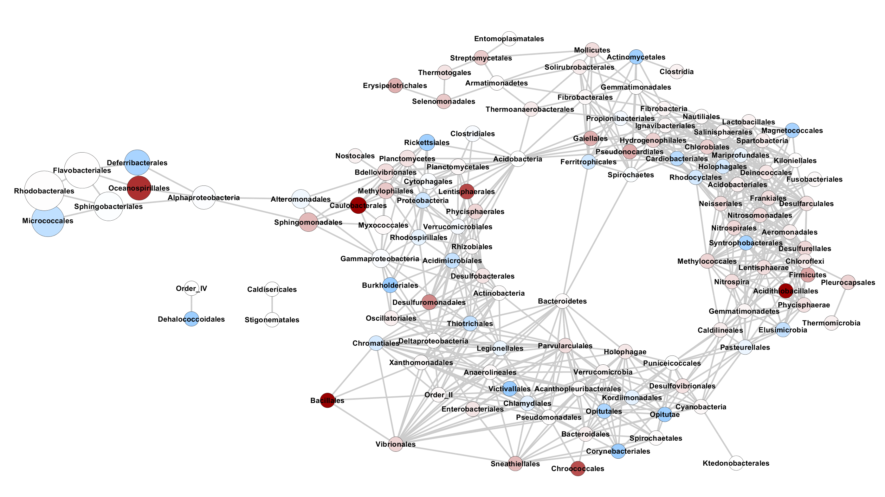
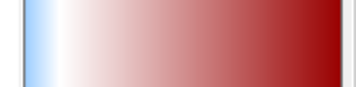
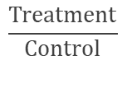
Occurrence
Number of Reads
22
1
0
2,720,000
1,350,000
675,000
2
$$\frac{Treatment}{Control}$$
Notes:
Figure 9. Co-occurrence network analysis using Bray-Curtis dissimilarity metric (max distance =0.4, Order level) for all water samples (n=18) in Trial 3. Taxa that change in the same way share an edge; nodes that have edges occur in the same proportions and in the same samples. Darker blue nodes indicate taxa that occurs in the Control significantly more than Treated water samples. White nodes have equal occurrence in treated and control water samples. Darker red nodes indicated taxa that occurs in the Treated significantly more than Control water samples.

Slide 13
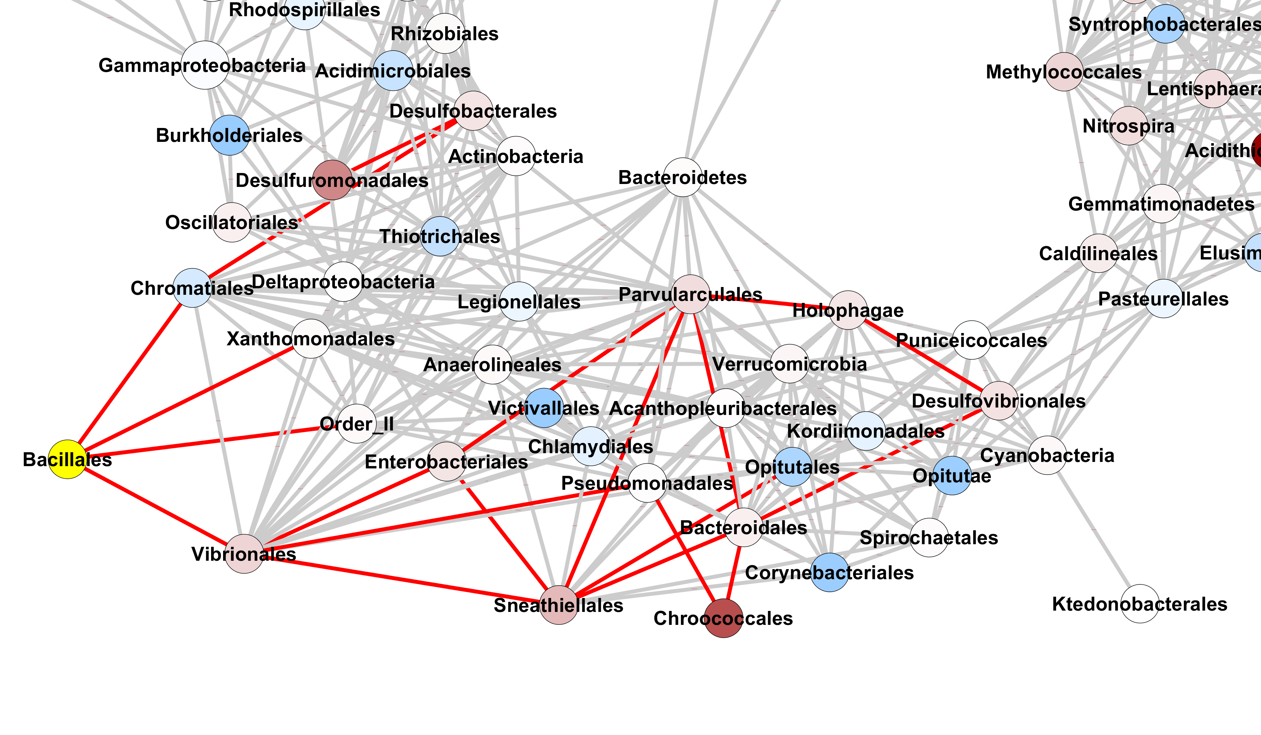
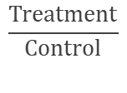
22
1
0
Proteobacteria;Gammaproteobacteria;Chromatiales
Proteobacteria;Gammaproteobacteria;Xanthomonadales
Bacteroidetes;Cytophagia;Order_II
Proteobacteria;Gammaproteobacteria;Vibrionales
$$\frac{Treatment}{Control}$$
Notes:
Figure 9 inset/zoom.

Slide 14
Supplementary Figures

Slide 15
Percent survival figure adapted from Modak et al., in prep
Notes:
Figure S1. Percent survival data in all Trials.

Slide 16
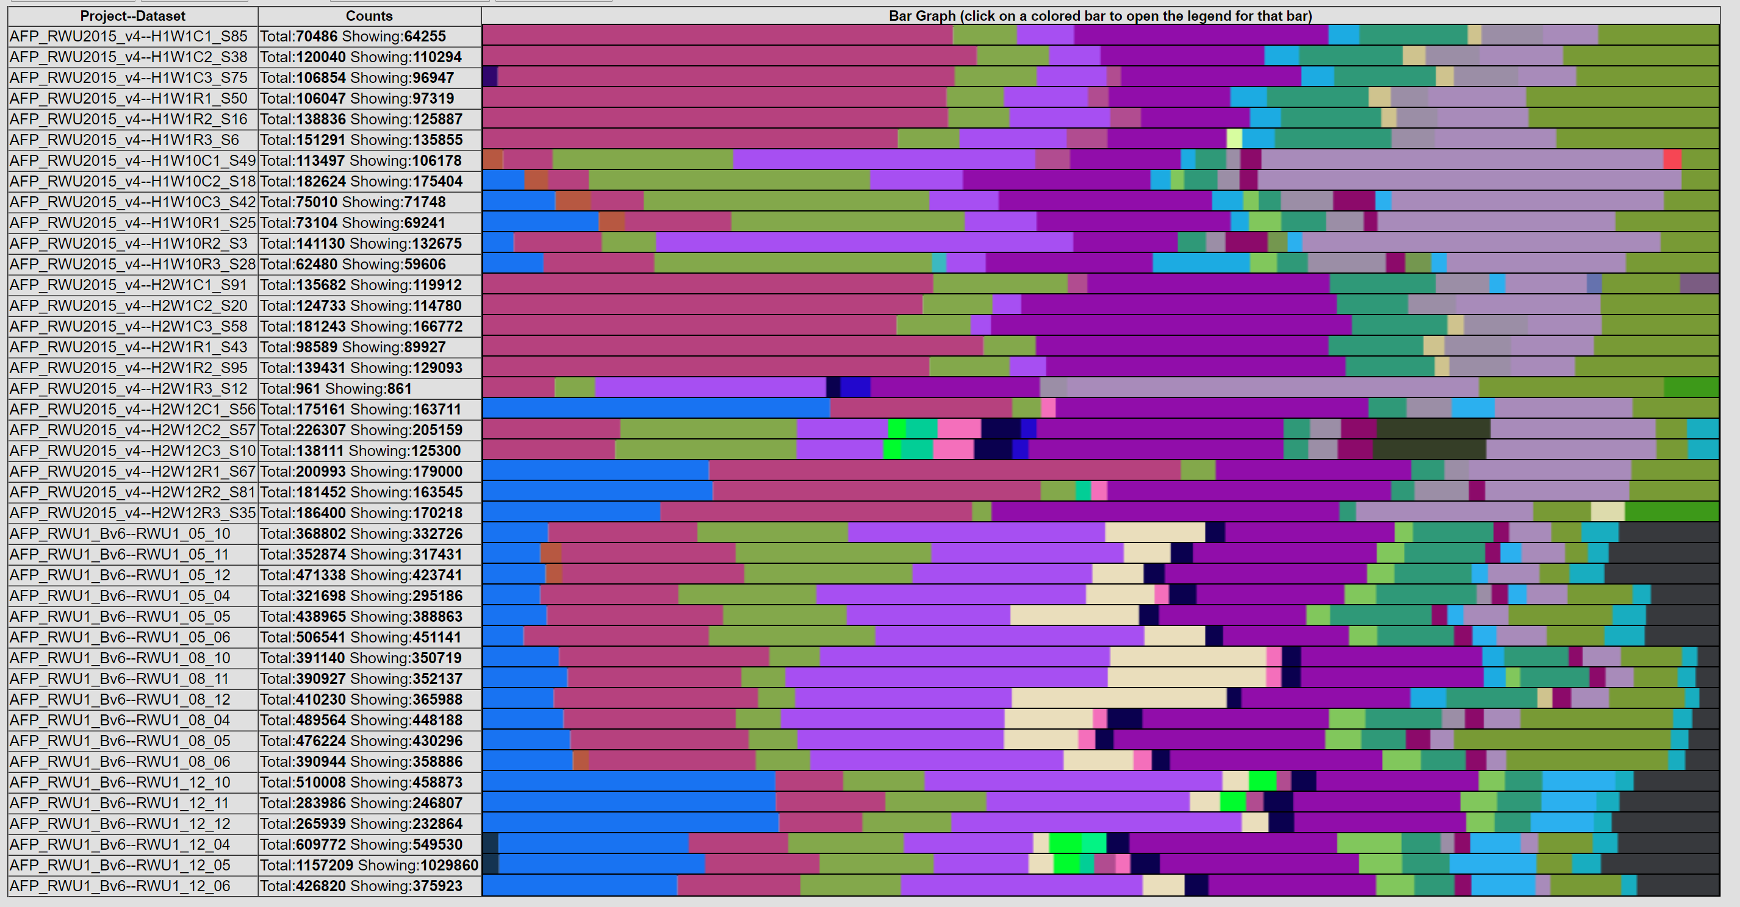
Trial
Day
Group
Abundance
1
2
3
1
12
1
9
5
8
12
Con
Treat
Con
Treat
Con
Treat
Con
Treat
Con
Treat
Con
Treat
Con
Treat
Notes:
Figure S2. Percent abundance in water samples by Order shows small changes in the same system. Total abundance of reads is shown in the bar graph.
Supplementary

Slide 17
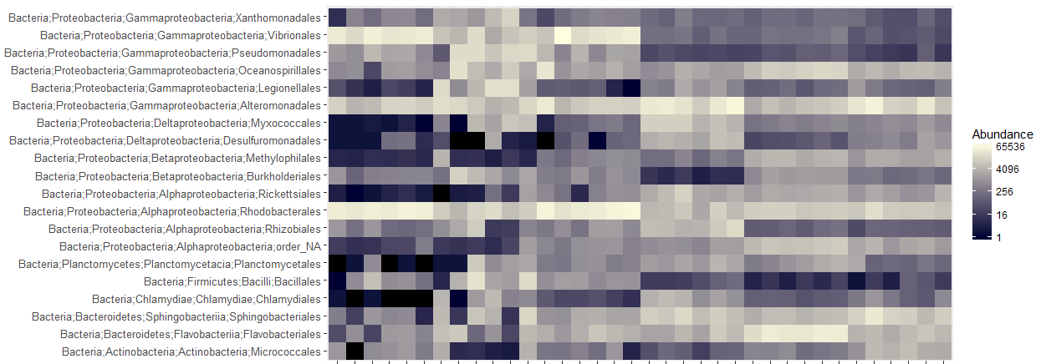
Day
5 12
5 12
1 12
Sample Type
Oyster
Swab
Water
Notes:
Figure S3a. The relative abundances of the 20 most abundant orders in oyster, swab, and water samples from Trial 1.
1275 x 602

Slide 18
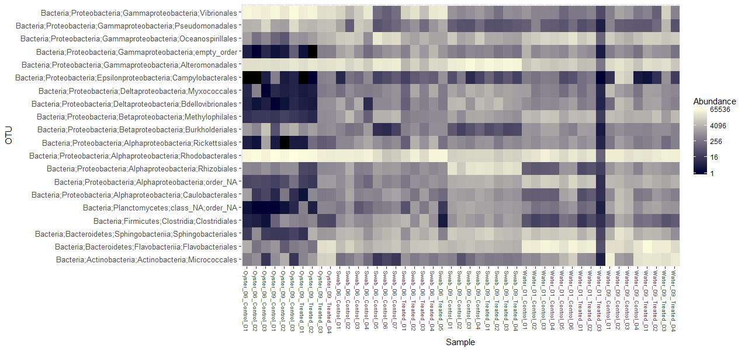
Day
6 9
6 9
1 9
Sample Type
Oyster
Swab
Water
Notes:
Figure S3b. The relative abundances of the 20 most abundant orders in oyster, swab, and water samples from Trial 2.
Supplementary

Slide 19
a) Trial 1
b) Trial 2
c) Trial 3
09
Group
Notes:
Figure S4. NMDS plots calculated using Bray-Curtis beta-diversity (k=2) at the Order level for water samples by treatment in Trials 1 (a), 2 (b), and 3 (c). The treatment group is indicated by colors (Control=light blue dashed, Probiotic treatment=dark red dotted) and sampling timepoints are indicated by symbols. The lines show the 95% confidence interval. The water community is not significantly different according to treatment.

Slide 20
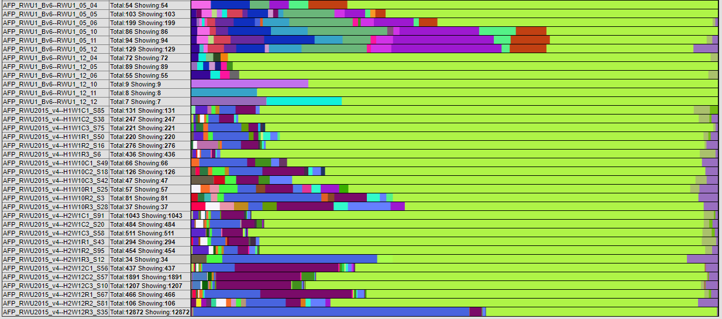
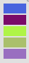
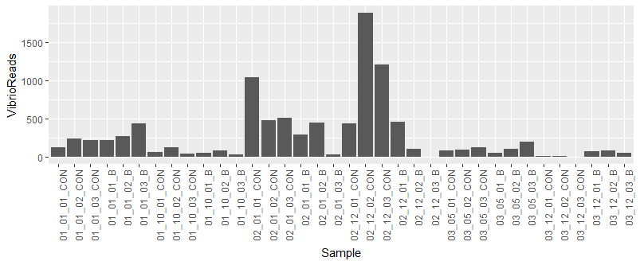
Trial
Day
Group
1
2
3
1
12
1
9
5
12
Con
Treat
Con
Treat
Vibrio anguillarum
Vibrio diabolicus
Vibrio spp.
Vibrio splendidus
Vibrio vulnificus
Con
Treat
Con
Treat
Con
Treat
Con
Treat
Notes:
Figure S5. The total abundance and structure of Vibrio reads in all three trials. The structure of total Vibrio counts in the rearing water is different between Trials and changes over time.
Supplementary??

Slide 21
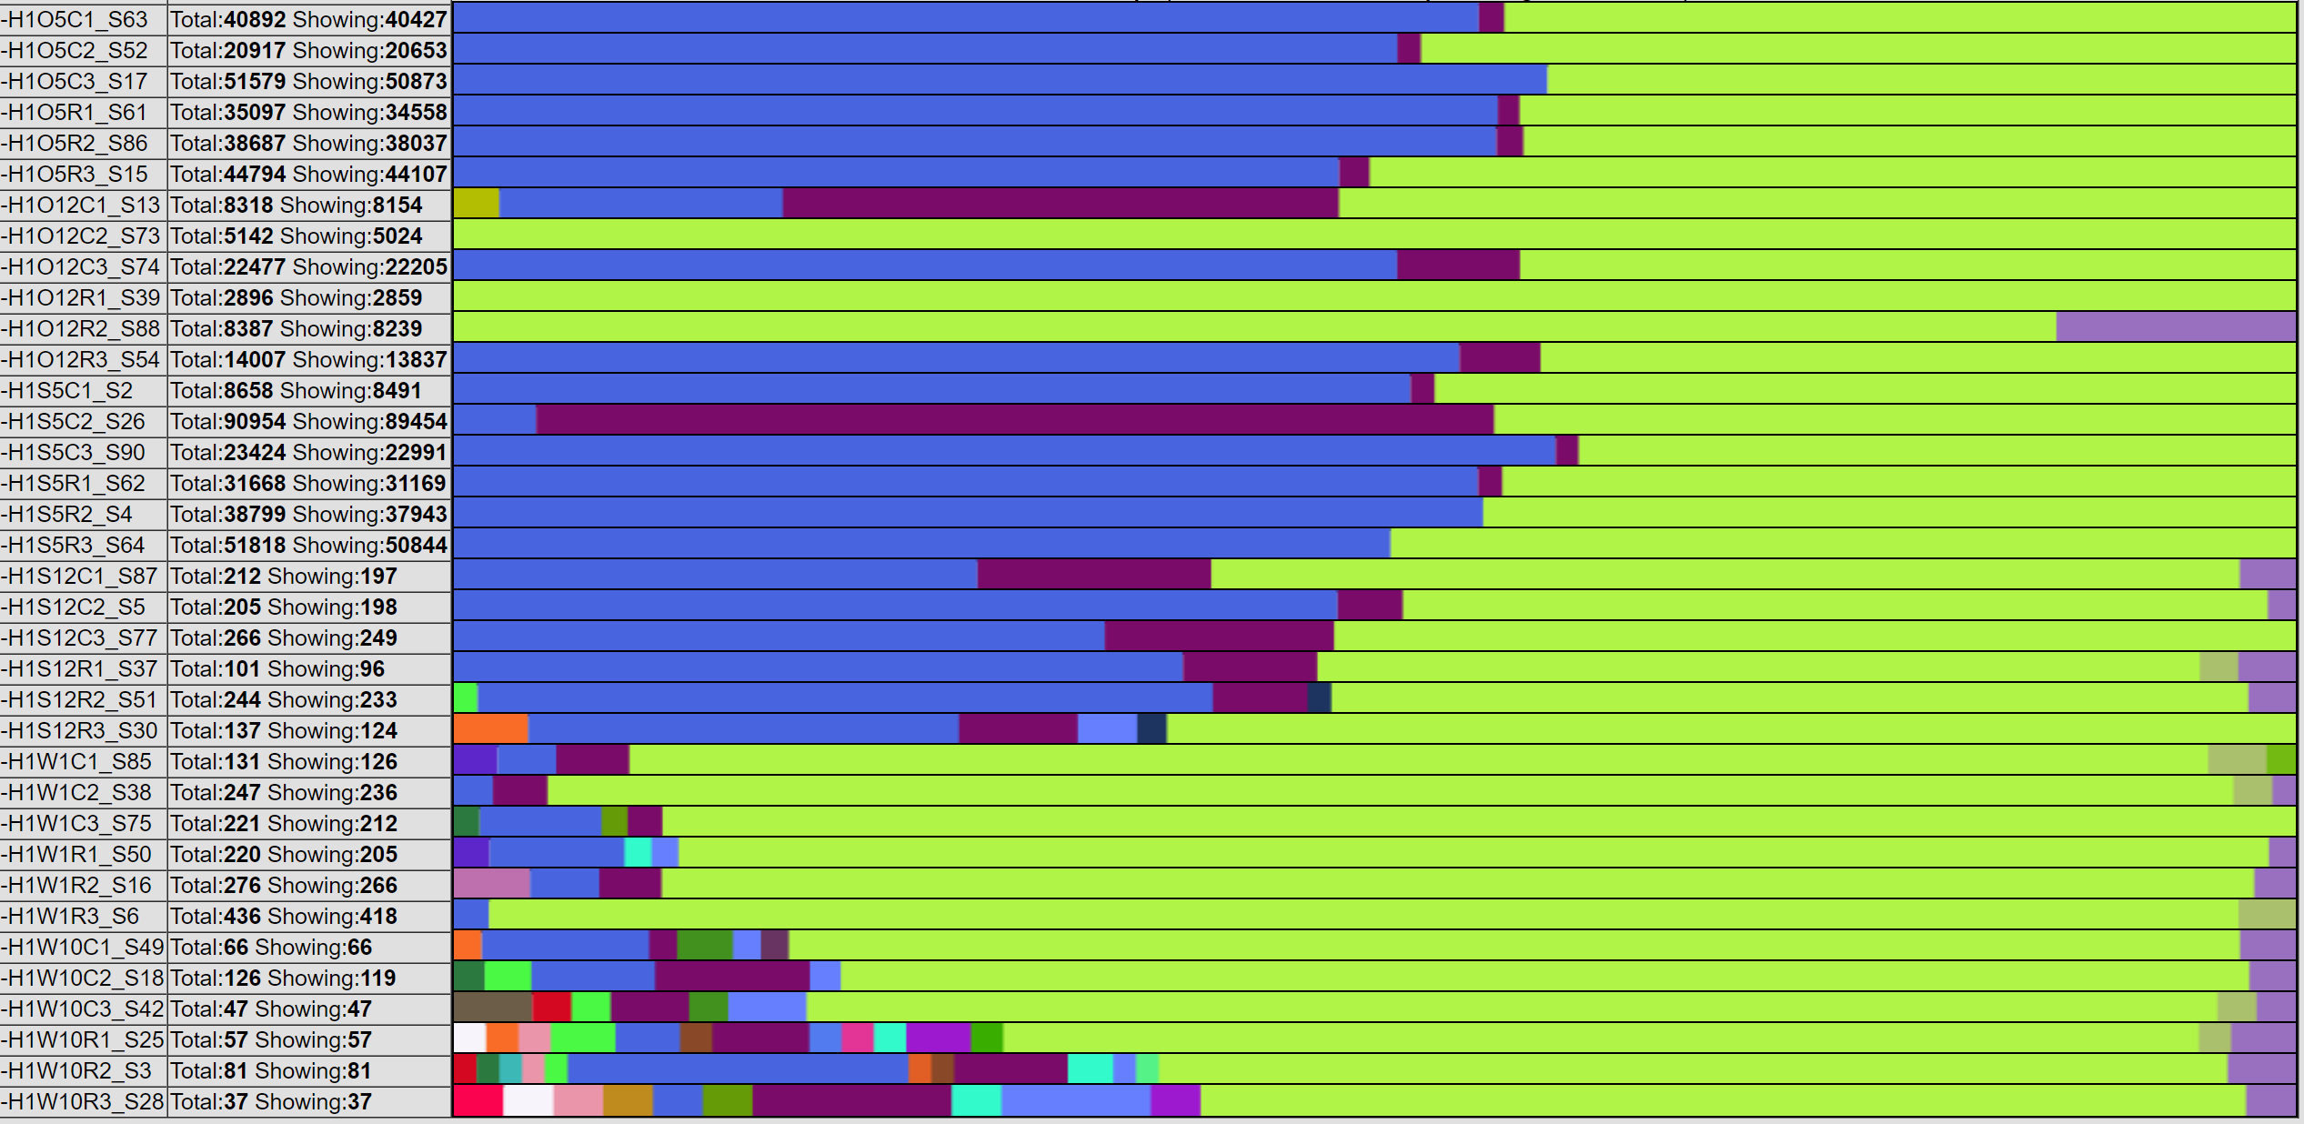
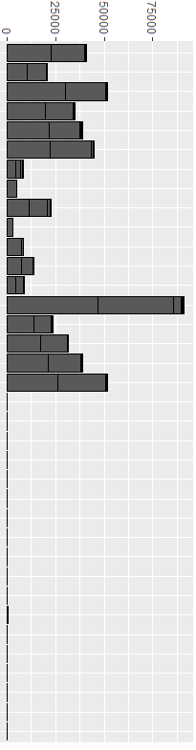
Sample
Day
Group
Water Swab Oyster
5
12
5
12
1
12
Con
Treat
Con
Treat
Con
Treat
Con
Treat
Vibrio anguillarum
Vibrio diabolicus
Vibrio spp.
Vibrio splendidus
Vibrio vulnificus
Con
Treat
Con
Treat
Notes:
Figure S6. The structure of total Vibrios is different based on the sample type and time point in Trial 1.

